Slide 1

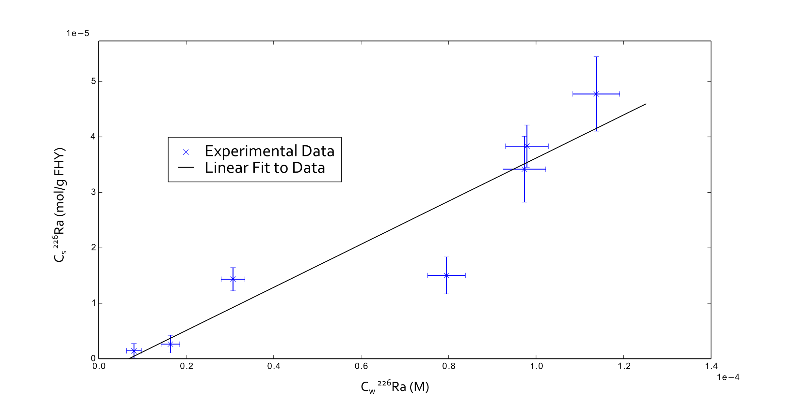
Radium Adsorption to Iron Bearing Minerals
AGU Fall Meeting 2014
Michael Chen, Benjamin Kocar
Abstract No: H11A-0841
Civil and Environmental Engineering, Massachusetts Institute of Technology, Cambridge, MA, United States
For more information, contact:
machen@mit.edu
I. Introduction and Objectives
II. Experimental Methods
Radium transport is a critical environmental process mediated by sorption to minerals, especially iron minerals such as ferrihydrite
Radium is a naturally occurring radioactive contaminant in fracking waste that could be released due to porewater transport through fracked shales, or by mishandling of produced water at the surface
Radium isotopes are also useful tracers for submarine groundwater discharge (SGD)
This work seeks to improve transport modeling of radium through sorption studies to iron minerals in varying conditions
Starting with ferrihydrite in pure water
Eventually using variable solution composition, expanded suite of minerals, in situ conditions, etc.
Procedure
Synthesize Ferrihydrite by dissolution of FeCl3 6 H2O in water, titration to a stable pH between 7-8, extraction and washing via centrifuge, and then adding water to make an FHY slurry
Slurry iron content measured via ICP-MS
Fresh slurry made every 1.5 weeks
Fill glass serum bottles with 1 mL FHY slurry, water, and varying amounts of ²²⁶Ra stock. (Standardized to 370 Bq per g of stock)
Some experiments take 2 mL sample for scintillation
Stopper bottles with butyl stopper and aluminum crimp cap, shake for 24 h
Measure pH and filter solution through 0.2 µm glass fiber syringe filter
Scintillation count total Radium and daughter products with 2 mL of filtered solution and 8 mL Ultima Gold XR
Experiment parameters
Slurry Iron Concentration = 13.3 ± 1.2 g/L
Solution Volume: 100.00±0.01 mL
Solid-Solution ratio: 0.13±0.01 mg/mL
Total ²²⁶Ra activities: 83 Bq, 167 Bq, 417 Bq, 833 Bq, 1250 Bq, 1667 Bq
Average pH before FHY addition: 3.53±0.04
24 hour shake time
Average pH after shaking: 3.75±0.02
Counting efficiency: 43%
SOME KIND OF IMAGE??? NOT SURE.
PROBABLY IMAGE OF FHY SORPTION BOTTLE
III. Preliminary Results
C_{w} found using sample taken in step 5
C_{s} found two ways:
C_{s} = C_{Step2} – C_{w} if available
Otherwise, C_{s} = V_{stock}C_{stock}-C_{w}
Error bars represent propagated analytical uncertainty
Linear fit done with NumPy polyval()
K_{d} = 0.39 g/L, R² = 0.87
pH change due to difference in ²²⁶Ra stock and FHY slurry pH
IV. Conclusions and Future Work
²²⁶Ra sorbs noticeably to ferrihydrite, suggesting it will play an important role in groundwater transport processes
Sorption behavior is mostly linear in this activity regime
Surface complexation modeling of radium to ferrihydrite with pH control
Additional isotherms with variations in solution composition closer to environmentally relevant conditions
Additional isotherms
Transport modeling using established K_{d} values

